Slide 1
Looking for ladybirds

Slide 2
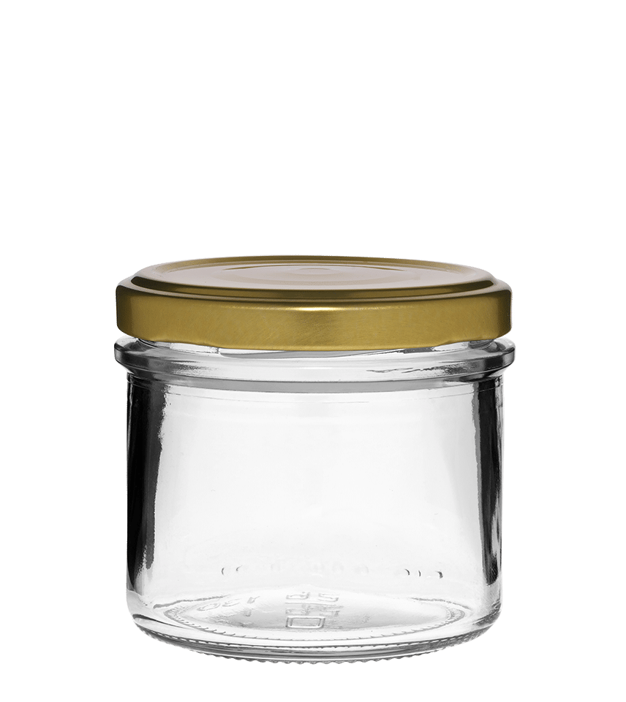
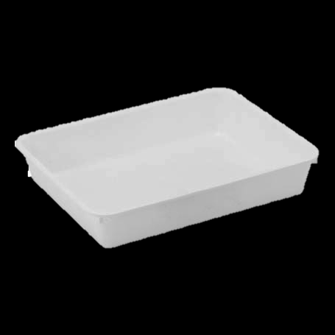
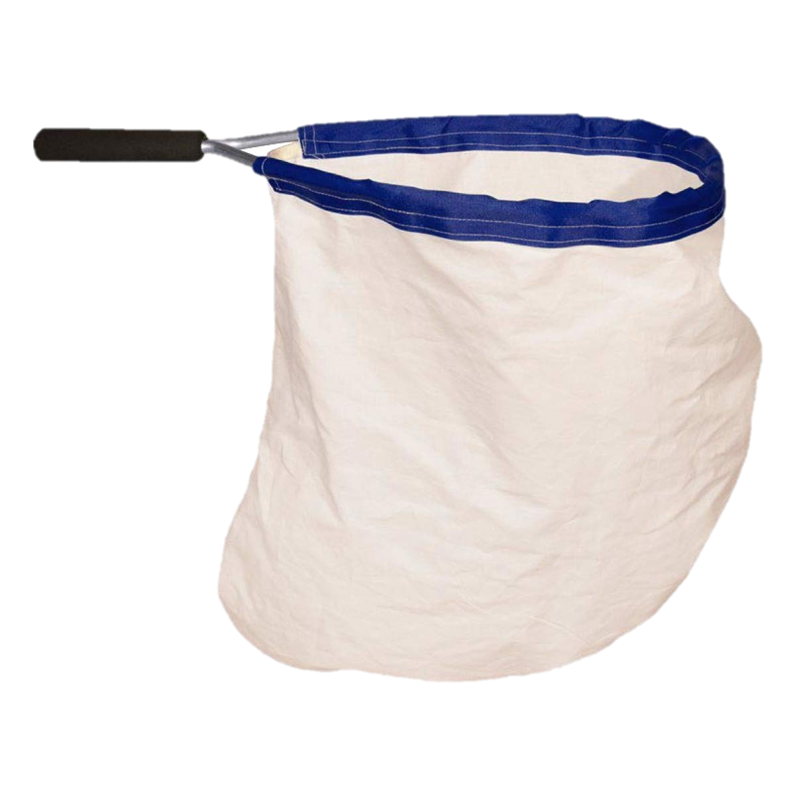
A-tier equipment
Sweep net
Look for: Sturdy fabric and frame
Used for: Sweeping through tall grass
Sweep net through tall grass. If using a pooter, use it to collect animals caught in the net. Or hold the net over a tray and flip the net inside-out so the animals fall into the tray.
Can also be used for: Bushes and shrubs
Hold the net under a branch and tap or shake the branch so things fall inside.
Sample tray
Look for: Sides ~5cm tall, light colour
Used for: Collecting animals
Hold under branches and tap or shake the branch so animals fall into the tray. Many animals can be observed just in the tray. If looking at things that can fly or climb out, transfer them into bug pots.
Can also be used for: Pond dipping
Fill the tray half-way with pond water. Use aquarium nets to catch pond animals and transfer them to the tray.
Bug pots or jars
Look for: Clear sides (anything will do!) Some have built in magnifier, but separate magnifying glasses are more versatile. Air holes are not needed if only keeping animals inside for a few minutes.
Used for: Collecting animals
Use brush and spoon/scoop to pick up animals and pop them inside.

Slide 3
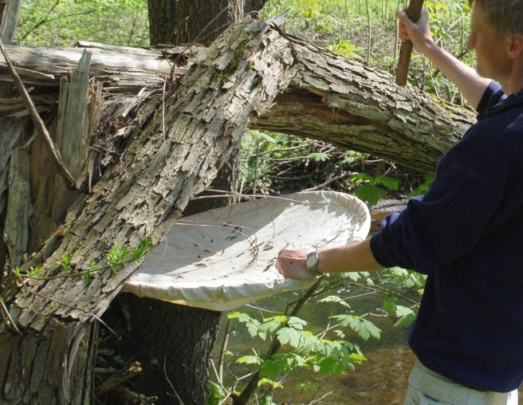
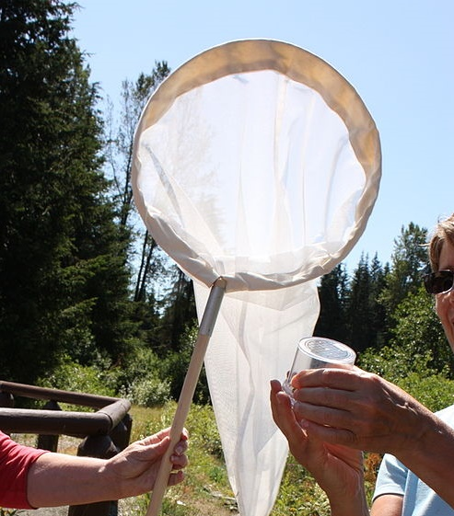
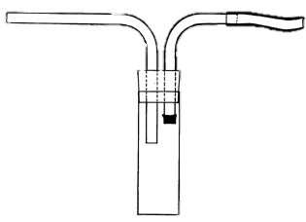
B-tier equipment
Pooter
Look for: Fine mesh over 1 tube. Ideally lid that can be swapped for one without tubes.
Used for: Quickly getting small animals into a container
Put the tube with mesh in your mouth. Then hold the other tube close to the animal and suck in sharply, like slurping soup. Practice with rice or lentils.
B-tier because: Mouth tube needs to be cleaned before use. Best suited to small invertebrates which can be more difficult for younger children to work with.
Beating tray
Look for: Wide area, light-coloured fabric. Sheets and pillowcases can work, handle and frame can be replaced with people holding the corners of fabric.
Used for: Collecting animals from trees and shrubs
B-tier because: A light-coloured tray can be used instead and is more versatile.
Butterfly net
Look for: Long handle, light weight, fine mesh.
Used for: Collecting flying insects
Swing the net at the flying insect. Then twist the handle so the fabric of the net drapes over the rim. The weight of the net will keep the flying insects from escaping.
Do not scrunch the net closed as you may squash the animals or damage their wings.
B-tier because: Fabric is easily damaged. Getting insects into a container from the net requires practice and patience. Winged insects like butterflies are easily harmed and often better left alone by children.

Slide 4
Ladybird survey

Slide 5


What is a survey?
Ladybird survey
A survey is a scientific test to gather information about a place or a population.
Example:
Raise your hand if you like to stay in bed when it is cold and rainy.

Slide 6
Ladybird survey
Survey question:
“Would you like to go outside?”
Recording detailed notes is important so others can tell if a test was fair.
Example
The teachers want to know which class likes to go outside the most. They conducted a survey. Each teacher asked their class if they would like to go outside.
Which class likes to go out the most?
 | Yes | No
Honeybee class | 23 | 7
Snail class | 10 | 20

Slide 7


Ladybird survey
Survey question:
“Would you like to go outside?”
Honeybee class did the survey on Monday when it was sunny outside.
Snail class had a test on Monday, so they did the survey one Tuesday instead. It was rainy outside on Tuesday.
Does Honeybee class really like going outside more than Snail class?
 | Yes | No | Weather when surveyed
Honeybee class | 23 | 7
Snail class | 10 | 20

Slide 8
What information do we need to record?
Ladybird survey
What do we want to find out about the ladybirds in our area?
What information do we need to answer our question?
Notes:
1. What do the students want to find out?
What is the best habitat for ladybirds? How many ladybirds are in the area? How many types of ladybird live in the area?
2. What information do they need to record in order to answer their question?

Slide 9
What information do we need to record?
Ladybird survey
What might affect our information collecting?
What might affect whether there are ladybirds or not?
What affects whether you want to go outside or stay in bed?
Notes:
3. Students should think about that might affect the information they are gathering.
Refer to the examples about weather affecting whether humans want to go out or stay in bed. Would this affect ladybirds?

Slide 10
Sharing survey results

Slide 11
Choosing how to present data
Sharing survey results
We can present data in different ways.
Tables show detail, but it is not easy to see patterns.
Graphs can make it easier to compare things or see patterns, but it is harder to see exact numbers.

Slide 12
Choosing how to present data
Sharing survey results
Presenting our data in different ways can also tell different stories.
How can you clearly present your data to answer the survey question?

Slide 13
We hope you found this resource useful!
Send your feedback to school-bookings@nhm.ac.uk
This resource was produced with support from Evolution Education Trust.

